Slide 1
Making our daily job easy
by reducing boilerplate code using Project Lombok
Doychin Bondzhev

Slide 2

Who am I
I work in my own company - dSoft-Bulgaria
Member of Bulgarian Java User Group – just like all other Java Developers in Bulgaria
Organizer of Java Beer events in Plovdiv – http://www.java.beer
member of JSR-377 expert group
Desktop|Embedded Application API

Slide 3
How to make our job easier
Problems
We need to write lots of code.
We also need to read/review other people’s code
We have lots of code that does not add value. It is there just because of the requirements of the Java language

Slide 4
How to make our job easier
Solutions
Use IDE to generate that code
Use another language that provides the necessary features

Slide 5


But we are Java developers
We want to use our favorite language

Slide 6
How to do it in Java?
Use Project Lombok
https://projectlombok.org/

Slide 7
What is Project Lombok?
It is a library that gives us a set of annotations
to help us get rid of all boilerplate code

Slide 8
How to use Lombok
Download lombok.jar from https://projectlombok.org/ and add it to your build class path.
Use it with maven
<dependency>
<groupId>org.projectlombok</groupId> <artifactId>lombok</artifactId>
<version>1.16.18</version>
<scope>provided</scope>
</dependency>
Gradle
provided group: 'org.projectlombok', name: 'lombok', version: '1.16.18'
Ant
<javac srcdir="src" destdir="build" source="1.8">
<classpath location="lib/lombok.jar" />
</javac>

Slide 9
@Getter and @Setter
Can be used on class or field
When used on class Lombok generates get/set methods to all non-static fields
When used on field Lombok generates get/set methods for that field
Has one parameter that tells what access level to use for get/set methods
By default access level is public

Slide 10
Next are equals(), hashCode() and toString()
@EqualsAndHashCode tells Lombok to generate for us equals() and hashCode()
@ToString tells Lombok to generate toString()
callSuper – This parameter indicates that call to the corresponding super method must be included during the evaluation of the corresponding method
of – comma separated list of field names to include in the evaluation of hashCode(), equals() and toString()
exclude – comma separated list of field names to exclude from the evaluation of hashCode(), equals() and toString()
Last two can’t be used at the same time

Slide 11
Constructors
@AllArgsConsutructor – generates constructor that will have all non-static fields as parameters
@NoArgsConstructor – generates default empty constructor
@RequiredArgsConstructor – generates constructor that will have as parameters all final and @NonNull fields
Common parameters
access – parameter to set the access level for the generated constructor. By default it is public
staticName – if set the generated constructor will be private and Lombok will add static method with the same set of parameters that will call the corresponding private constructor

Slide 12
@Data - one annotation to rule them all
Used on class as shortcut for @ToString, @EqualsAndHashCode, @Getter, @Setter, @RequiredArgsConstructor
You can customize parameters for any of the above annotations by adding it and providing the necessary values
staticConstructor – a parameter that tells Lombok to generate static constructor method and constructor for the class to be private. The name of the method is the value of staticConstructor parameter.

Slide 13
Where we can use these annotations?
Any class that conforms to Java Bean specification
DTO classes
JPA entity beans

Slide 14
One thing to note
NOTE: Be careful with relational fields that build bi-directional relations between classes.
Must use of or exclude parameters for @EqualsAndHashCode and @ToString in order to avoid StackOverflowError

Slide 15
Creating immutable classes
@Value – equivalent to @Data but for immutable classes
Converts all non-final fields to final and provides only get methods to access them.
@Wither annotation placed on a field adds “set” method that returns new instance of the class with changed value in that field.

Slide 16
Builders made easy
@Builder – annotation that generates builder API for your data class
This annotation has parameters to customize Builder class name, build and builder method names
@Singular – annotation used on fields that are collections from java.util or com.google.common.collect
Note: This annotation requires from you to provide values for all fields including for those having initial value

Slide 17
More for @Builder
@Builder.DEFAULTS – a new annotation that is supposed to “help” with initial values
Better don’t use it. It breaks your code when you try to directly create instance of your class.

Slide 18
@Synchronized
Can be used on methods but does not synchronize on this like synchronized method modifier
Synchronizes on private field $lock which is automatically created if it is missing
You can specify another field to use for synchronization

Slide 19
try-with-resource without java.io.Closeable
Resource allocator class
class RAllocator {
void doSomethingWithResource() {}
void dispose() {}
}

Slide 20
try-with-resource without java.io.Closeable
Code before compilation:
public class CleanupExample {
public static void main(String[] args) {
@Cleanup("dispose")
RAllocator allocator = new RAllocator();
allocator.doSomethingWithResource();
}
}

Slide 21
try-with-resource without java.io.Closeable
Code after compilation:
public class CleanupExample { public CleanupExample() {} public static void main(String[] args) { RAllocator allocator = new RAllocator (); try { allocator.doSomethingWithResource(); } finally { if (Collections.singletonList(allocator).get(0) != null) { allocator.dispose(); } } } }

Slide 22
Other useful annotations
@Log, @Log4j, @CommonsLog, @JBossLog, @Log4j2, @Slf4j, @XSlf4j – add and initialize private static final log field to your code for the corresponding logging framework

Slide 23
Other useful annotations
@NonNull – automatic null check
when used on method parameter it adds check in the code to generate NullPointerException in case parameter is null. The message of the exception contains the name of the parameter.
when used on field it indicates that this field should not be null and all methods that set value to this field will contain null check

Slide 24
Other useful annotations
@SneakyThrows - throw checked exceptions without throws
Source code:
public class SneakyThrowExample { public static void main(String[] args) { new SneakyThrowExample(); } @SneakyThrows public SneakyThrowExample() { throw new Exception(); } }

Slide 25
Other useful annotations
@SneakyThrows - throw checked exceptions without throws
Compiled code from class file
public class SneakyThrowExample { public static void main(String[] args) { new SneakyThrowExample(); } public SneakyThrowExample() { try { throw new Exception(); } catch (Throwable ex) { throw ex; } } }

Slide 26
@Accessors
chain – set this parameter to true to have your setter methods return this.
fluent – Set this parameter to true if you prefer fluent API instead of get/set naming schema. This sets chain to true.
prefix – comma separated list of prefixes used in the naming of your fields. Lombok will remove the prefix from the field name when evaluating the name for the corresponding get/set method

Slide 27
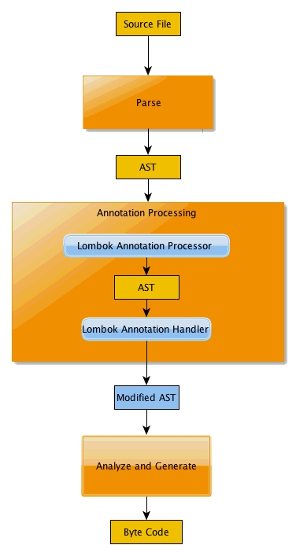
How it works
Lombok works at annotation processing level and provides access to Abstract Syntax Tree to it’s annotation handlers.
The annotation handlers do their magic by altering that AST – adding classes, fields, methods and expressions to generate the necessary code.

Slide 28
How to add your own extensions
Create a fork from Lombok source code on github
Add your code in the corresponding packages
Build distribution and use it in your projects
Contribute back your code if you think it can be used by others

Slide 29
Integration with your IDE
Supported IDE’s are
Eclipse and other eclipse based IDE– supported by lombok installer
NetBeans – just add lombok.jar to your project libraries and enable annotation processing in Editor
IntelliJ – requires third-party plug-in that is available in IntelliJ repositories

Slide 30
Resources
https://projectlombok.org
How to create extensions (old but gives general idea what to do) https://notatube.blogspot.bg/2010/12/project-lombok-creating-custom.html
YouTube – lots of tutorials and presentations from other conferences

Slide 31
Q & A

Slide 32
Thank you

